Slide 1

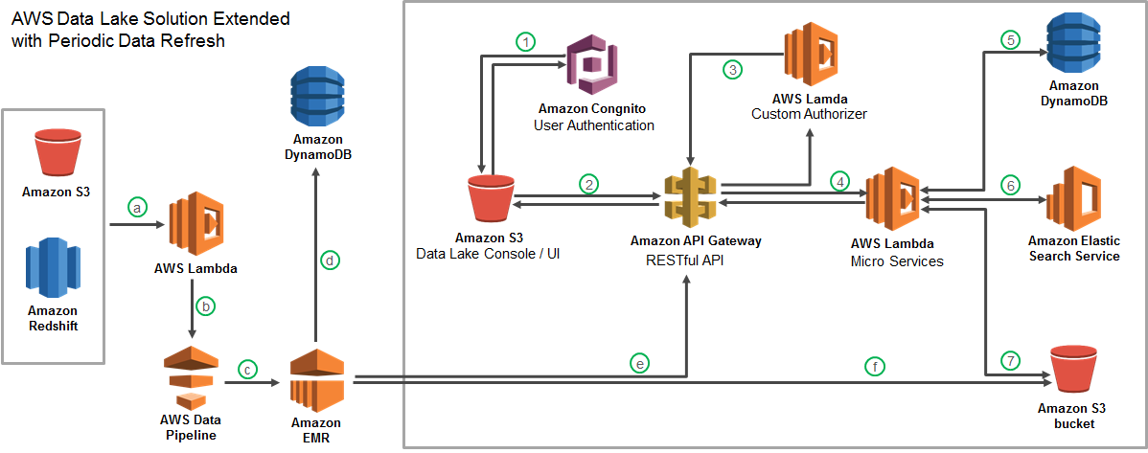



Cloud based data lake to enhance Analytics Operations
Largest Food Distributor in the US
The Problem: Ageing legacy Business Analytics Infrastructure with high cost of ownership slowing down realizable analytics value
The “Before” State
LatentView Solution
The “After” State
Business users faced significant delays in accessing and analyzing data and had difficulty in handling large volumes of data for analytics
Migrated 60TB of data from legacy systems into a cloud based data lake with extended periodic data refresh which supports reporting and advanced analytics solutions
Reduced cost of ownership and increased throughput of cloud hosted analytics solutions
Recommendation Engine
Order Anomaly Detection
Product Substitution
Revenue Management Use Cases
Notes:
Sysco – Data Engineering – SEED Platform

